Slide 1

Swiggy Analytics System
Presentation By Anirudha Pradip Johare

Slide 2


Introduction
The Swiggy Analytics System is designed to simulate and analyze data from a food delivery platform, inspired by India’s growing food delivery industry.
The goal of this project is to analyze customer behavior, delivery performance, and restaurant operations to solve key business problems.
This project demonstrates how data analytics can drive operational efficiency and customer satisfaction.”

Slide 3
OBJECTIVE
To create a structured database for managing food delivery data.
To Solve Problems about customer behavior, restaurant performance, and delivery operations.
To derive insights that help improve efficiency, enhance customer experience, and boost revenue.

Slide 4
Problems Statement
Food delivery businesses face several challenges, such as delayed deliveries, uneven restaurant performance, and inconsistent customer satisfaction.
There is a need for a reliable analytics system to manage datasets and extract insights to address these issues.
This project aims to solve these problems by providing a structured approach to data management and analysis.”

Slide 5

Dataset Overview
“In this project, I worked with a dataset that includes five main tables:
Restaurants: Stores details like restaurant names, cuisine types, and ratings.
Customers: Contains information about customer names, cities, and order histories.
Deliveries: Records delivery personnel, times, and statuses.
Orders: Tracks order dates, amounts, and statuses.
Menu Items: Includes details about the items offered by each restaurant.

Slide 6
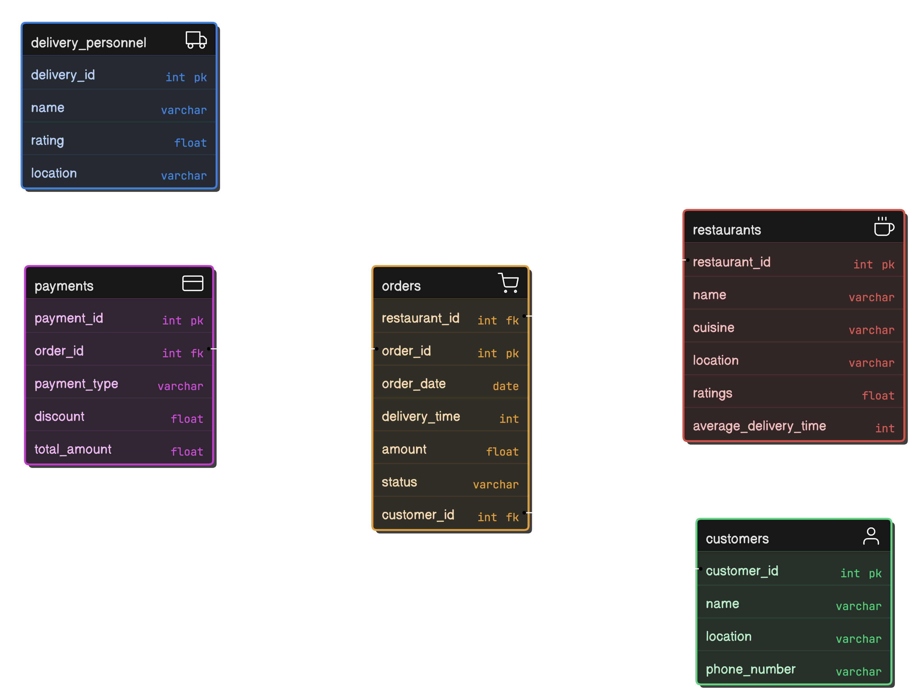
Entity Relationship Diagram
One-to-Many: Customers → Orders, Restaurants → Menu_Items.
• One-to-One: Orders → Deliveries.

Slide 7
Queries And Solutions

Slide 8

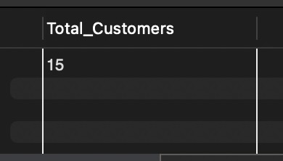
1. How many total customers are there in the system?
I used a simple COUNT query on the Customers table to determine the total number of customers.
This helps understand the size of the customer base, which is essential for planning marketing strategies and measuring market penetration

Slide 9
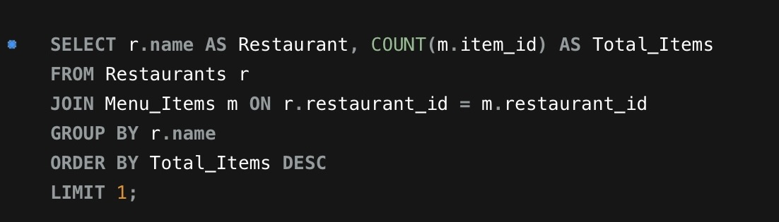
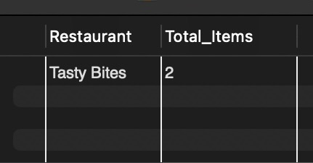
2. Which restaurant has the most menu items?
I counted the number of menu items for each restaurant using a JOIN between the Menu_Items and Restaurants tables and sorted the results in descending order
This identifies the restaurant offering the widest variety, which can attract customers looking for diverse options.

Slide 10

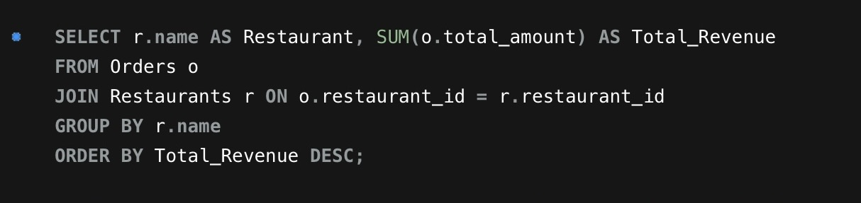
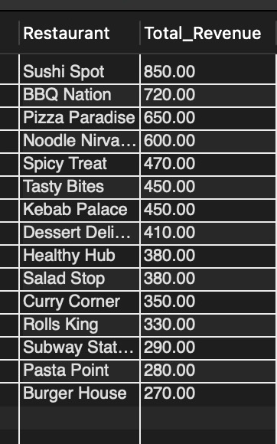
3. What is the total revenue generated by each restaurant?
I grouped the order amounts (SUM) by restaurant using a JOIN between Orders and Restaurants.
This highlights the top-performing restaurants, helping prioritize business relationships and promotional strategies.

Slide 11
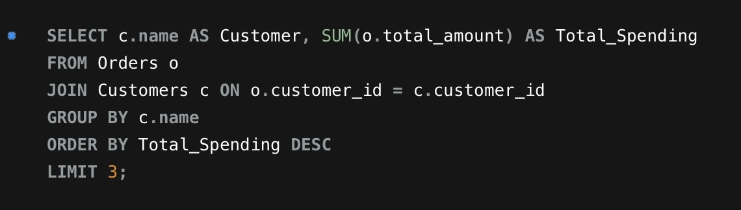
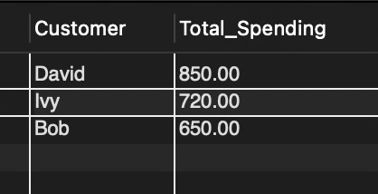
4. Who are the top 3 customers with the highest total spending?
I summed up the total order amounts for each customer and sorted them in descending order, limiting the result to the top 3.
This helps identify high-value customers who can be targeted with loyalty programs and personalized offers.

Slide 12
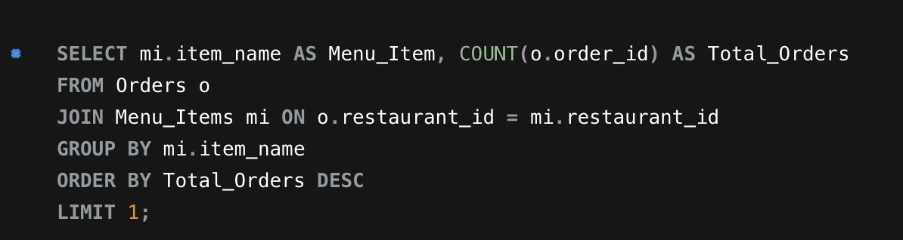
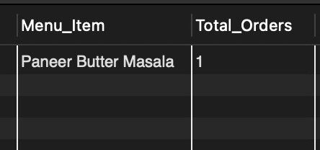
5. Which menu item has been ordered the most?
I used a COUNT query on order IDs grouped by menu item names from the Menu_Items table.
This determines customer preferences, enabling focused marketing for popular items.

Slide 13
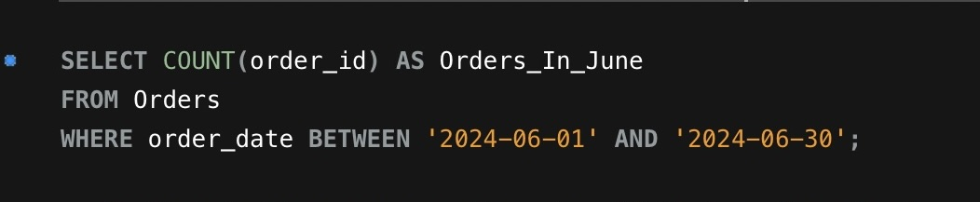
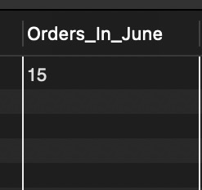
6. How many orders were placed in June 2024?
I filtered the Orders table using a date range for June 2024 and counted the orders.
This provides insights into monthly order trends, helping plan for seasonal demand.

Slide 14
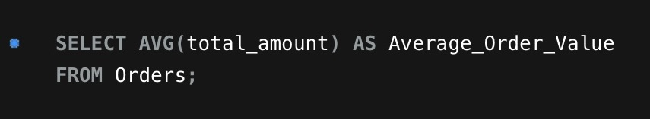
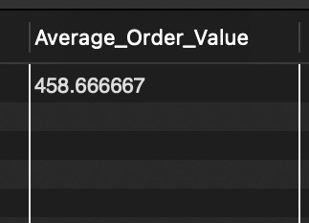
7. What is the average order value for all orders?
I used the AVG function on the total amount column in the Orders table.
Knowing the AOV helps set pricing strategies and design promotional campaigns.

Slide 15
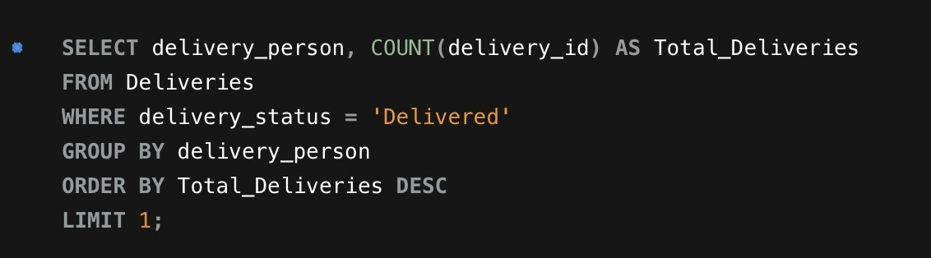
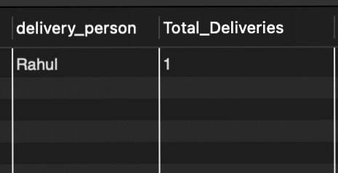
8. Which delivery person completed the most deliveries?
I counted the number of completed deliveries grouped by delivery personnel in the Deliveries table.
Identifying top-performing delivery personnel helps recognize their contributions and set benchmarks for others.

Slide 16
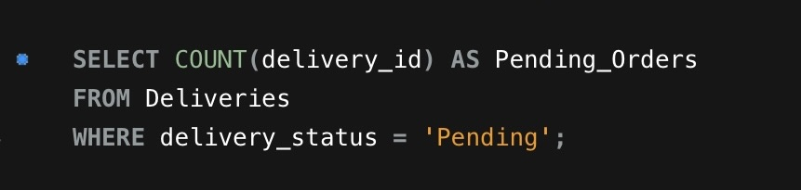
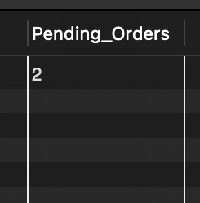
9. How many orders are pending delivery?
I filtered the Deliveries table for orders with a Pending status and counted them.
Monitoring pending deliveries helps address operational delays and improve customer satisfact

Slide 17
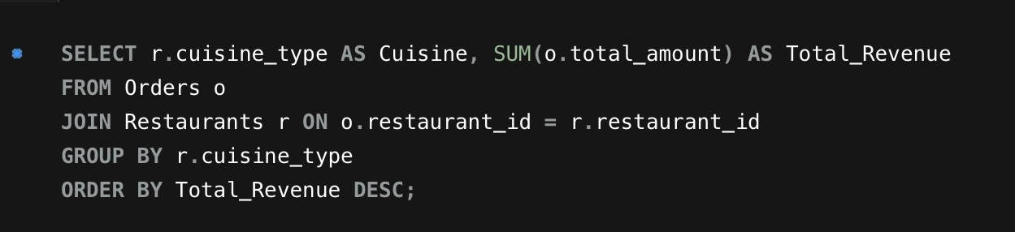
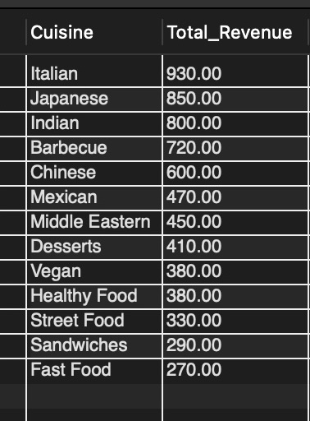
10. Which cuisine type generated the most revenue?
I summed up order amounts grouped by cuisine type using a JOIN between Orders and Restaurants.
This helps prioritize cuisines that drive revenue and align marketing efforts accordingly.

Slide 18
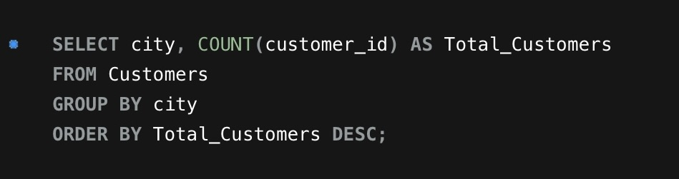
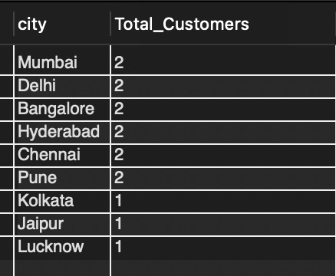
11. How many customers are from each city?
I grouped customers by city and counted them using the Customers table.
This helps understand customer distribution across locations and plan for targeted regional expansions.

Slide 19
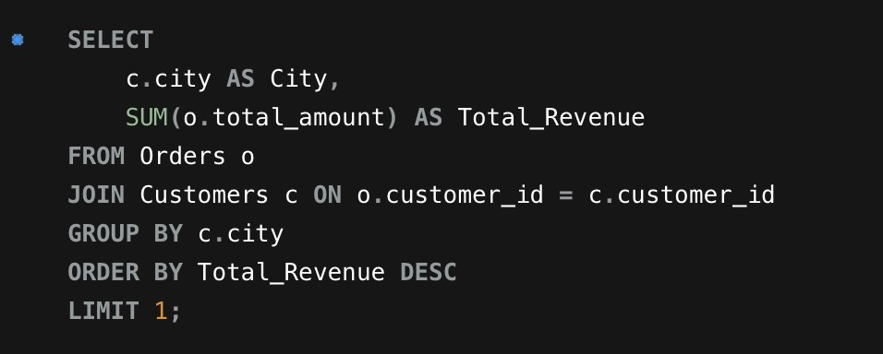
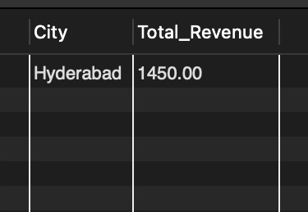
12. Which city generates the highest revenue?
I joined the Orders and Customers tables to link orders with the respective cities. Then, I calculated the total revenue generated by each city and sorted the results to find the highest-revenue city.
This information helps identify high-performing locations, enabling targeted marketing campaigns and resource allocation in areas with higher demand and spending.

Slide 20
THANK
YOU

